Slide 1


U-Band Imaging of the Extended Groth Strip
Caleb Redshaw
Mentor: Dr. Rogier Windhorst
School of Earth and Space Exploration,
Arizona State University
AZSGC Symposium, University of Arizona
April 23, 2022

Slide 2
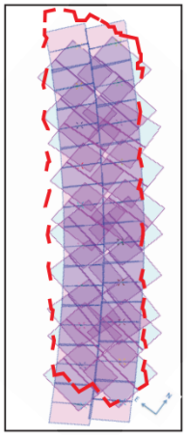
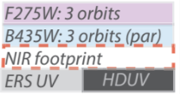
Background: UVCANDELS
Ultraviolet Imaging of the Cosmic Assembly Near-infrared Deep Extragalactic Legacy Survey Fields
Successor to CANDELS
Four fields observed in near UV
Ground-based U-band complements
Overall Goal: Study galactic evolution
from z = 0.5 to 3
Figure from uvcandels.ipac.caltech.edu

Slide 3
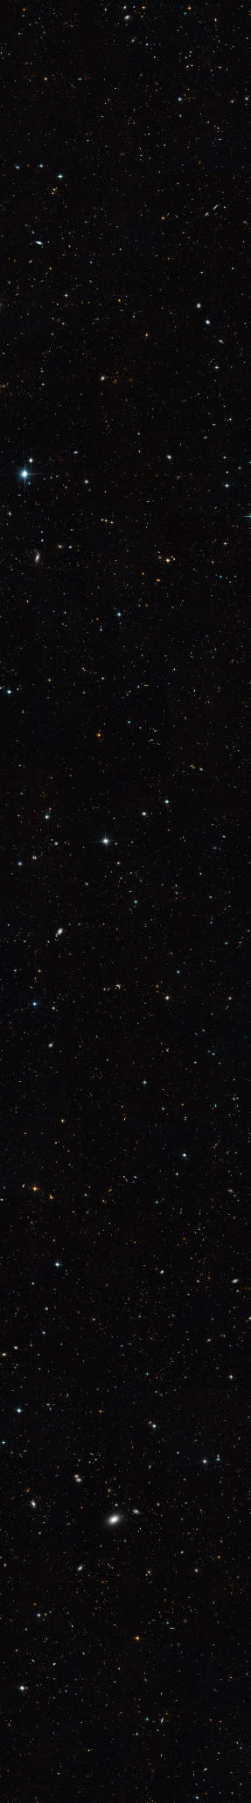
Extended Groth Strip
Figure from esahubble.org/images/opo0706c/

Slide 4
Data
LBT/LBC Blue Channel, SDT_Uspec
  λ_{c} ≃ 359nm; Δλ ≃ 54 nm
324 U-band images of the EGS
300 or 360s each
Total exposure time ~30.8hrs

Slide 5
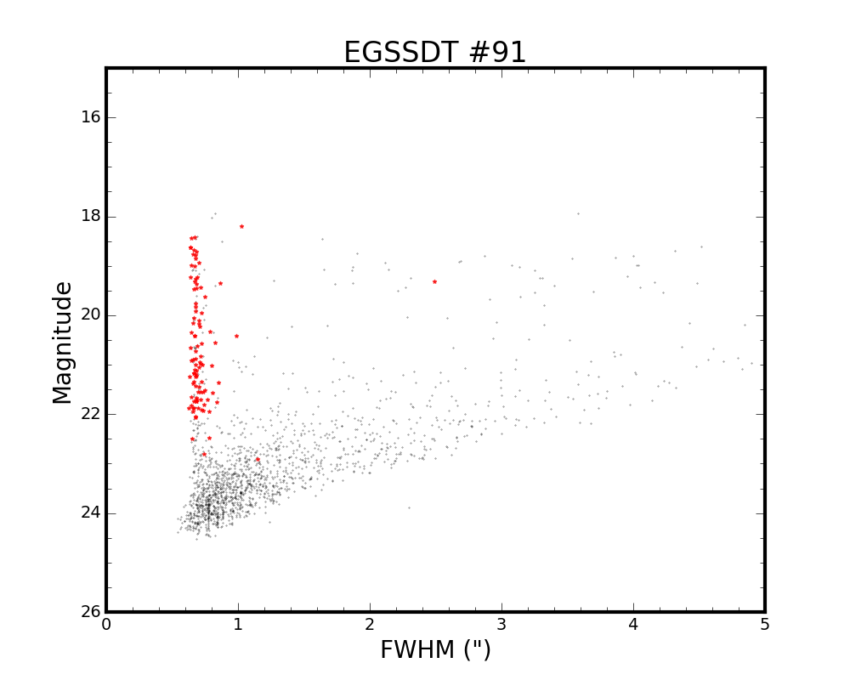
First Steps - Seeing
Stars matched to SDSS
Measured seeing of each exposure

Slide 6
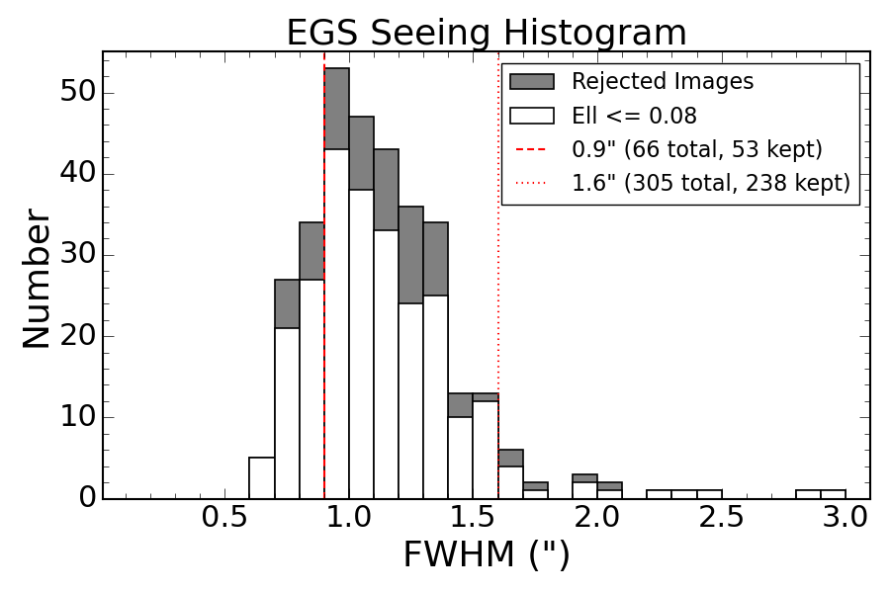
First Steps - Seeing

Slide 7
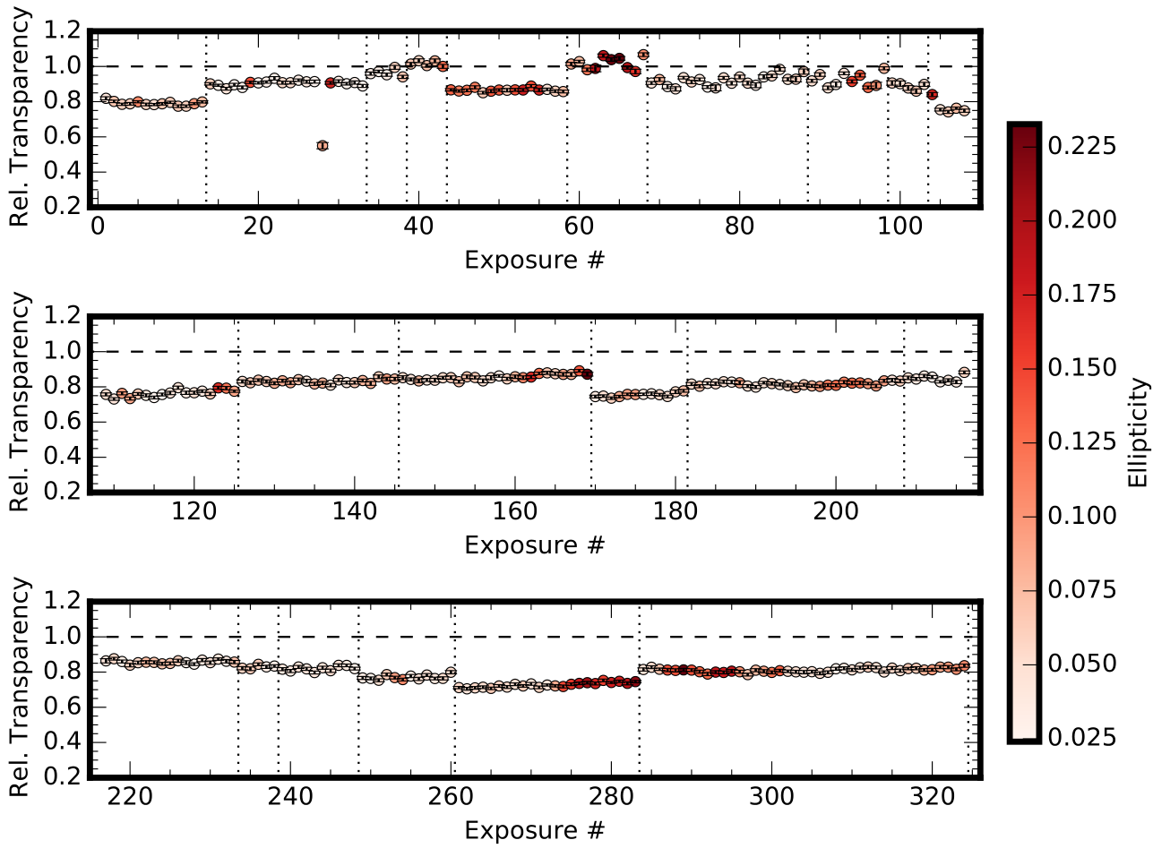
Transparency Corrections

Slide 8
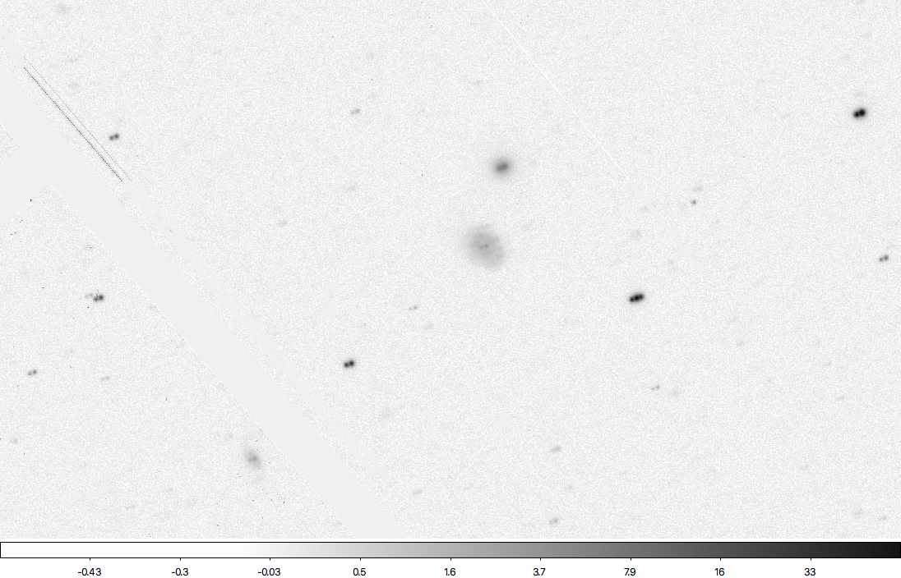
Transparency Corrections
Problem?

Slide 9
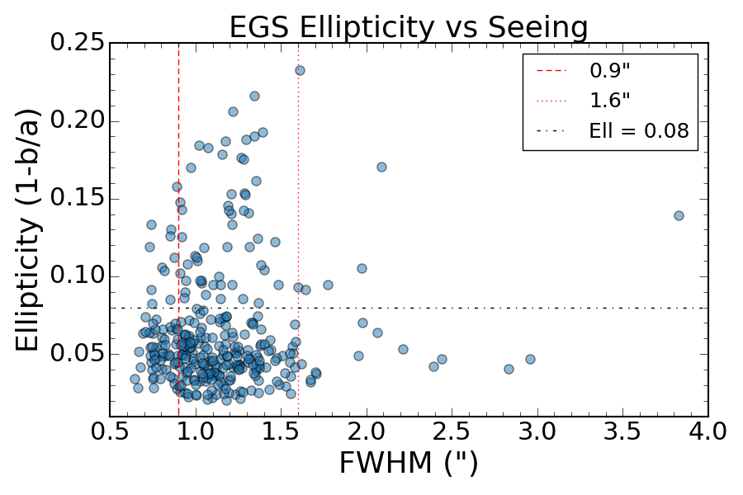
Analyzing Ellipticity
‘Clump’ of good data below 8%
All other images rejected

Slide 10
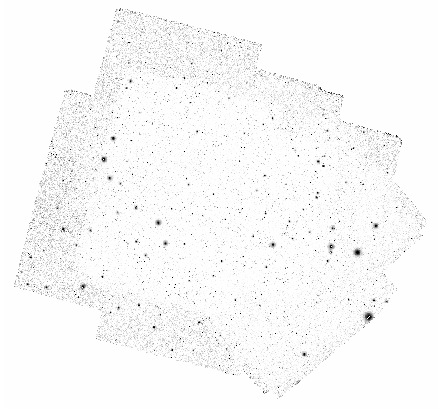
Final Mosaics
FWHM | Image Count | Total Exp. Time (hrs) | Mean Exp. Time (min) | 50% Complete Depth
0.9” | 53 | 4.98 | 5.64 | U ~ 26.25
1.6” | 238 | 22.78 | 5.74 | U ~ 26.75

Slide 11
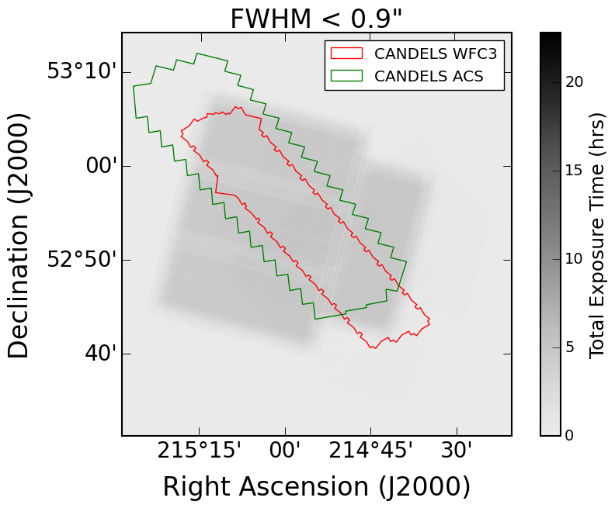
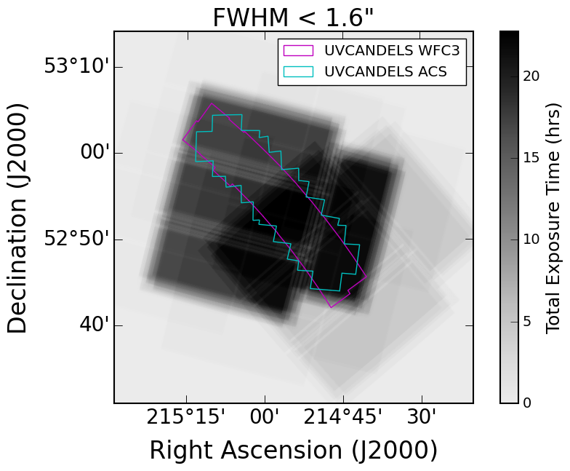
Final Mosaics

Slide 12
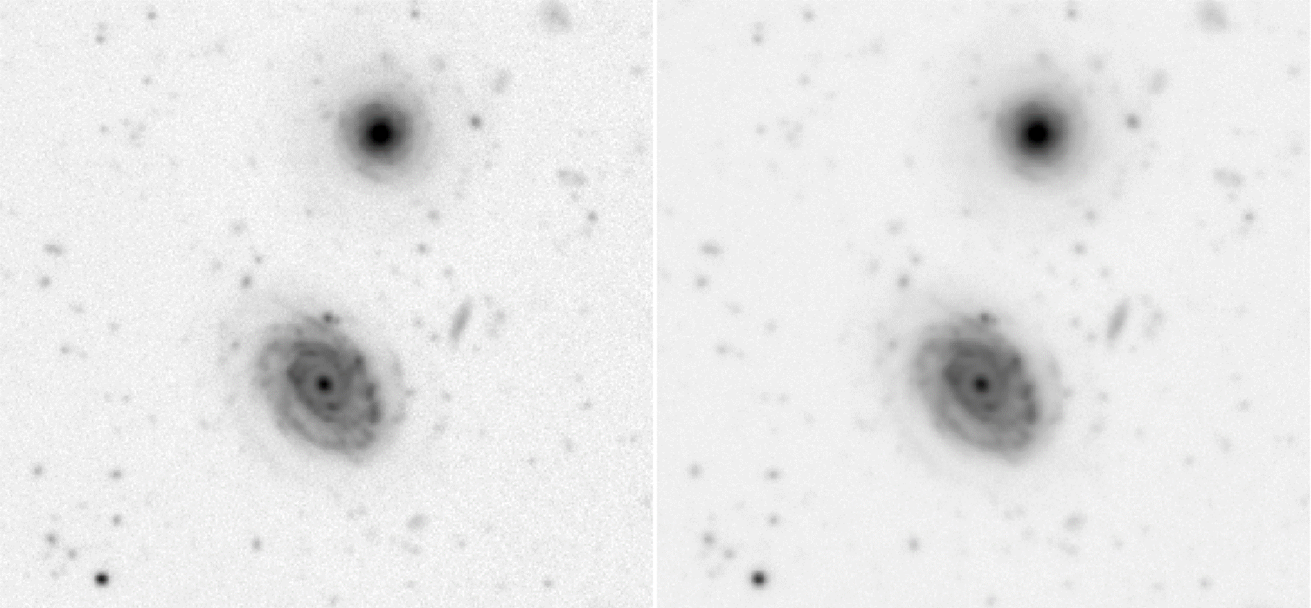
Final Mosaics

Slide 13
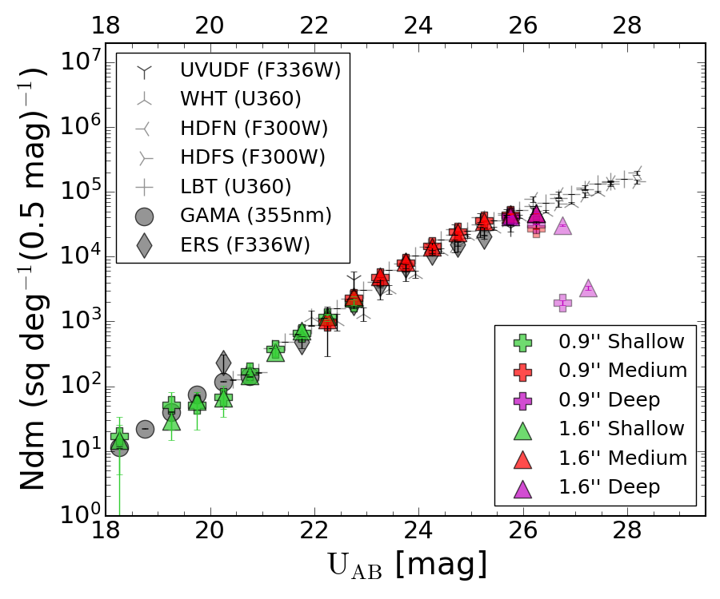
Galaxy Counts
Compared galaxy counts to other U-band data
0.9” counts ‘turn over’ first, 1.6” counts are slightly deeper
Not as deep as prior ASU results

Slide 14
Conclusions
Filtering for ellipticity improves quality at the cost of exposure time
Both mosaics are necessary for different applications
Wrapping up LBT UVCANDELS: this data can be used with extant HST and future JWST observations to study galactic evolution in these regions

Slide 15
Acknowledgements
Dr. Rogier Windhorst
Tyler McCabe & Lillian Otteson
Rolf Jansen, Seth Cohen, Timothy Carleton
The rest of the LBT UVCANDELS Team
ASU/NASA Space Grant

Slide 16
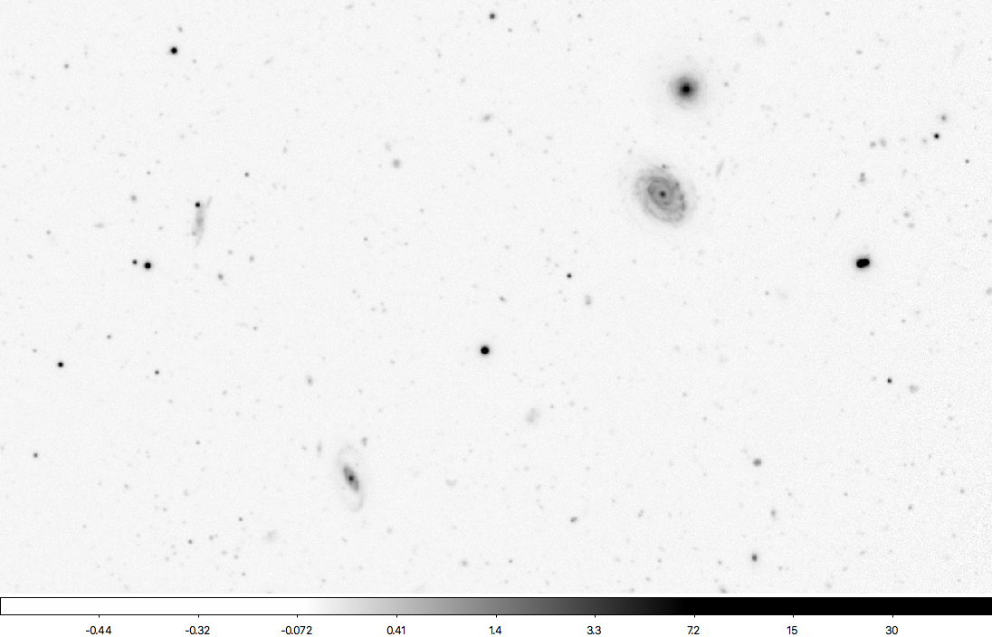
Thank you!

